Slide 1
I-Spy Challenge
By: Michael Pedersen

Slide 2

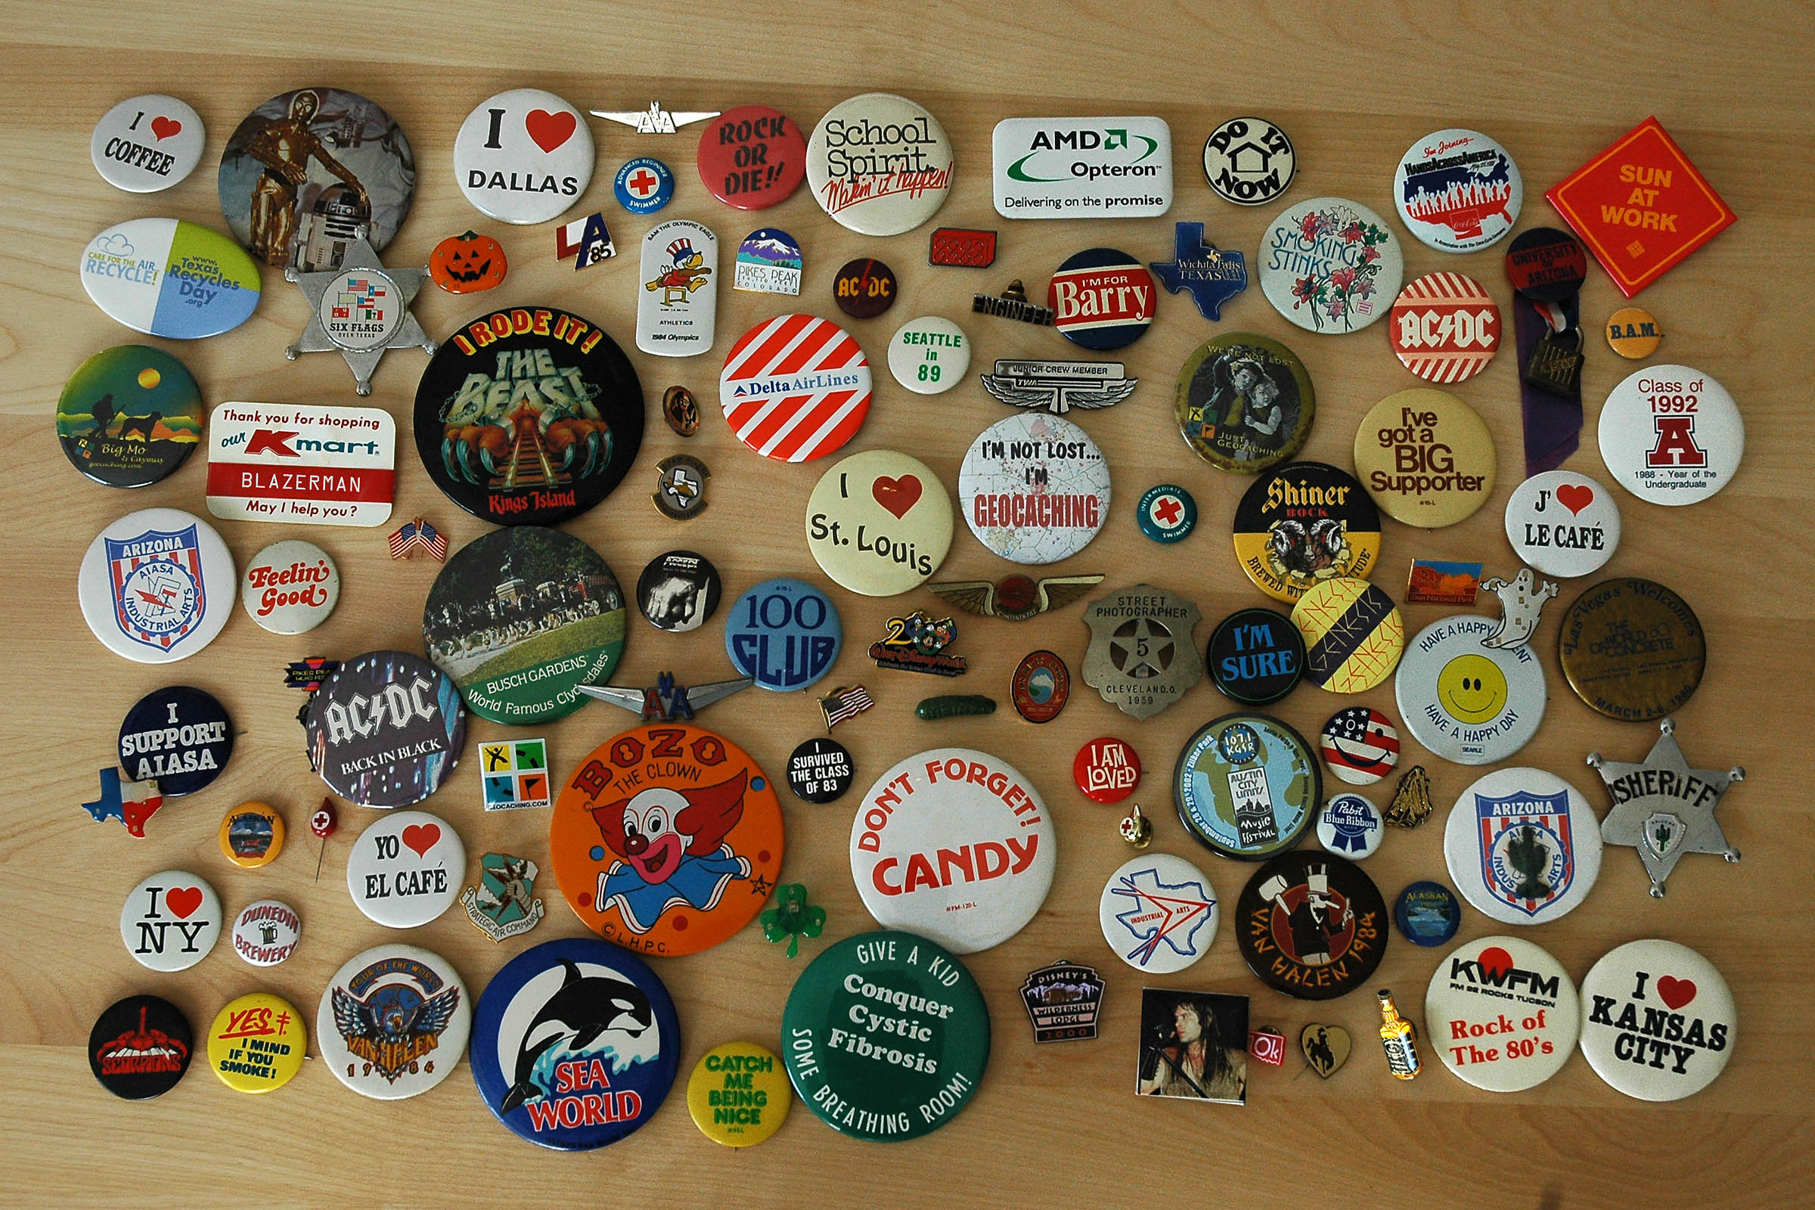
Brute Force Solution
Loop through rows and columns of big image comparing against only the first pixel of the small image.
If the first pixel matches try the entire small image.

Slide 3
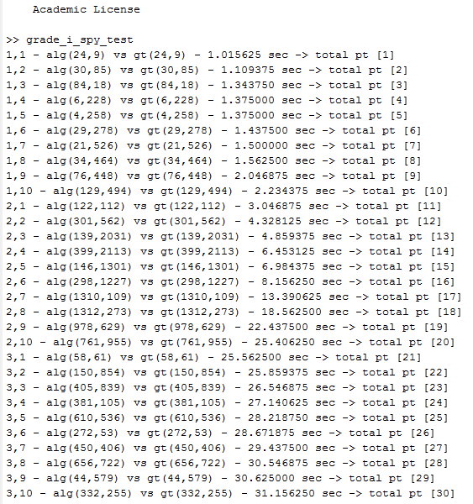
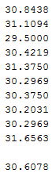
Brute Force Timings
About one second per image
Massive slowdown on large images
(Especially the second )
Good start but can we do better?

Slide 4
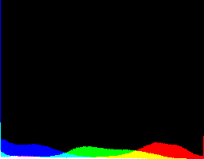
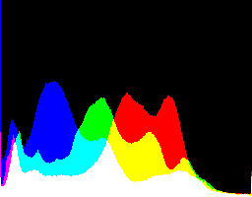
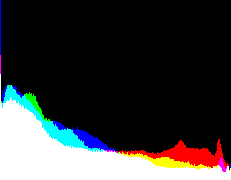
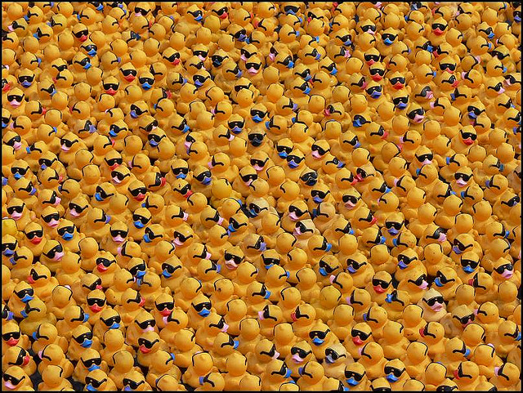
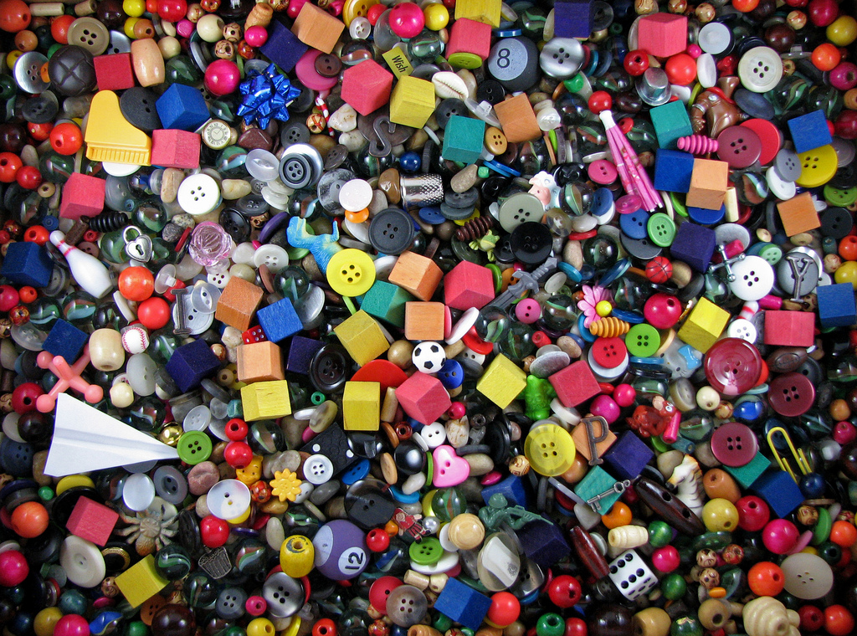
Developing X
Notes:
The brute force only cares about pixels that are the same color as the top left pixel of the small image so what if I can pregenerate that?
Wouldn’t it be great if I could use the abundance of color to my advantage? - uniqueness is the key to speed.
I thought I could speed up the the naive solution by making a list of what pixels in the big Image correspond to the same rgb value. To do this efficiently I wanted to see if I could get away with using the fewest number of To do this I looked at the height of each color in histograms of each big Image to find out which colors are most prevalent. The height of each color in the histogram show how many

Slide 5
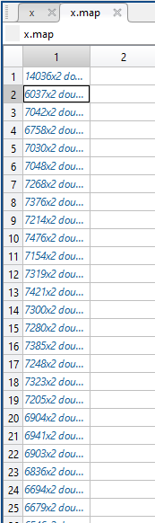
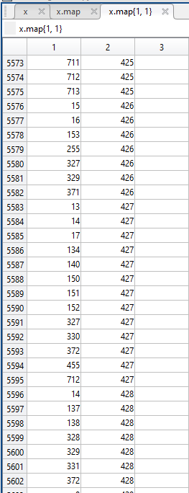
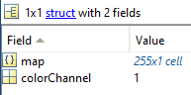
Precompute X
Same as the brute force solution with these additions:
Extract the red channel from each pixel
Use red value to add the pixel x,y coordinate into the x.map matrix
Notes:
Since Matlab is great at matrices I decided to create a 3d matrix where the first two dimensions represent the rgb value of blue and red. At each cell in this two dimensional array is a cell array holding a list of pixel coordinates.

Slide 6
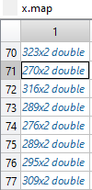
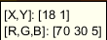
Processing X
3492
978
2240
5556
2862
823
3241
373
636
528
377
572
518
650
348
333
373
270
417
668
613
348
3574
3052
3403
2973
3268
Take the center row of the small image and find the color with the fewest amount pixels in the big image (x.map matrix).
Then start the brute force method on the array at that red index.
Notes:
I chose the center row because all of the small images are centered on a subject, the center row as a result, has more

Slide 7
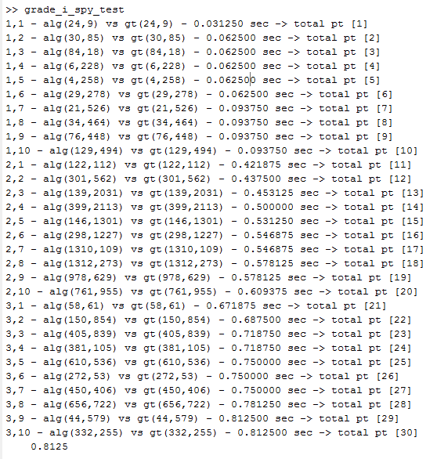
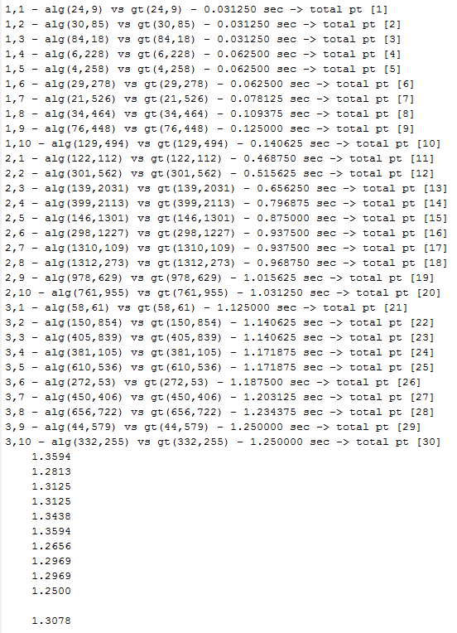
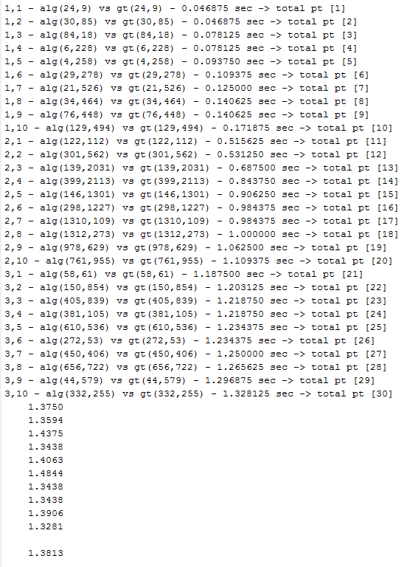
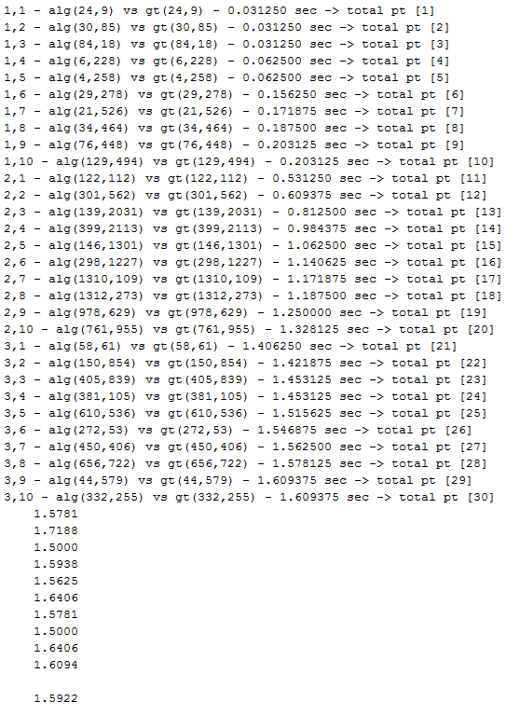
Performance
Bruteforce performance: ~30 seconds
Using precomputed X: ~1 - 1.5 seconds

Slide 8
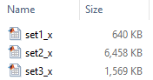
Scenarios
Best Case:
On a computer with super fast SSD or ram disk
Big image has unique combination of red values in each pixel
Small image is literally a pixel
Worst Case:
Every pixel is the same/similar red value (either in the big or small image)
High resolution images

Slide 9
Questions?

